Slide 1
PRODUCT SALES ANALYSIS BY MYSQL

Slide 2
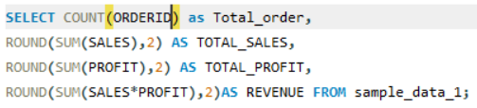
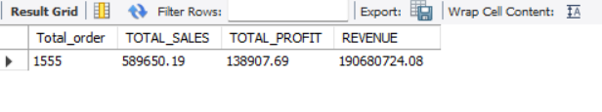
KEY METRICS
THESE CODES SHOWS THE KEY METRICS
TOTAL ORDER - 1555
TOTAL SALES – 589K
TOTAL PROFIT -138K
TOTAL REVENUE -19M

Slide 3
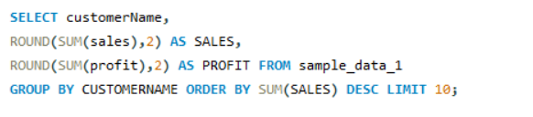
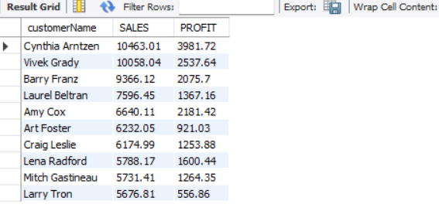
TOP 10 CUSTOMERS SALES AND PROFIT WISE
CYNTHIA AND VIVEK ARE THE MOST LOYAL CUSTOMERS

Slide 4
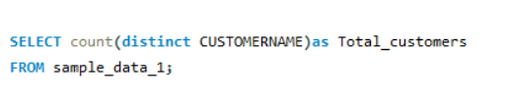
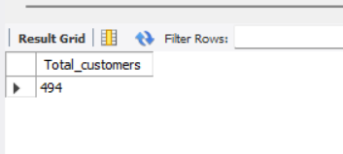
TOTAL CUSTOMERS :- 494

Slide 5
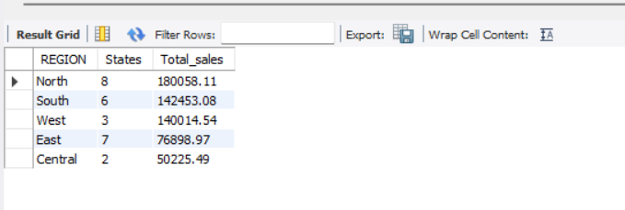
REGIONAL SALES OVERVIEW BY STATES
NORTH REGION HAS THE HIGHEST SALES AND HIGEST NUMBER OF THE STATES COME UNDER THE NORTH
SALES OF 180K AND 8 STATES

Slide 6
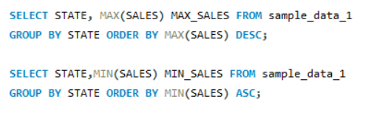
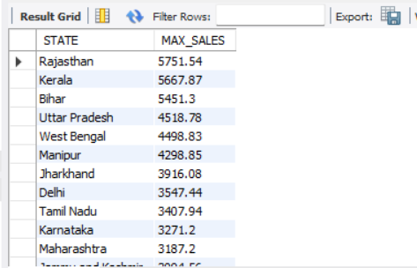
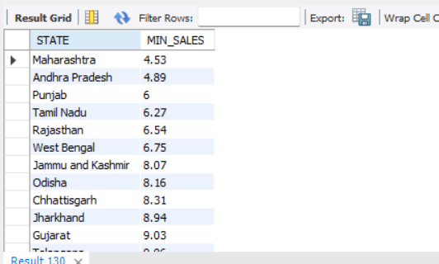
MAXIMUM & MINIMUM SALES BY STATES
RAJASTHAN HAS THE MAXIMUM SALES OF 5751 AND
MAHARASHTRA HAS THE MINIMUM SALES OF 4.53

Slide 7
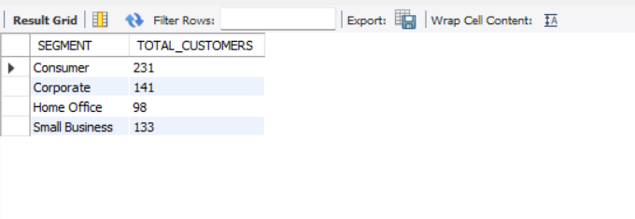
SEGMENT WISE CUSTOMER COUNT
CONSUMER SEGMENT HAS THE HIGEST CUSTOMERS ARE 231 AND HOME OFFICE HAS THE LEAST CUSTOMERS ARE 98

Slide 8

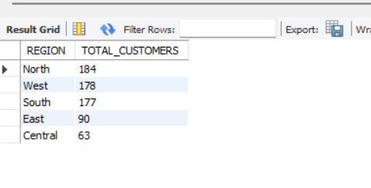
REGION WISE CUSTOMERS COUNT
MOSTLY CUSTOMERS ARE FROM THE NORTH REGION, 184 CUSTOMERS

Slide 9

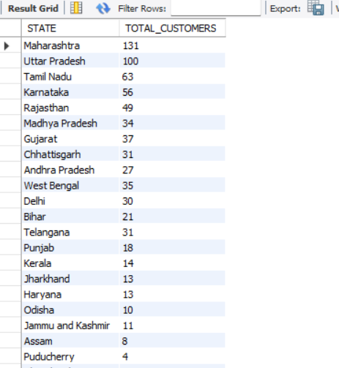
STATE WISE CUSTOMER COUNT
MAHARASHTRA HAS THE MOST CUSTOMERS,
CUSTOMER COUNT 131

Slide 10
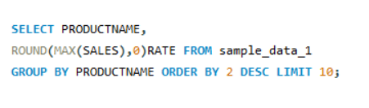
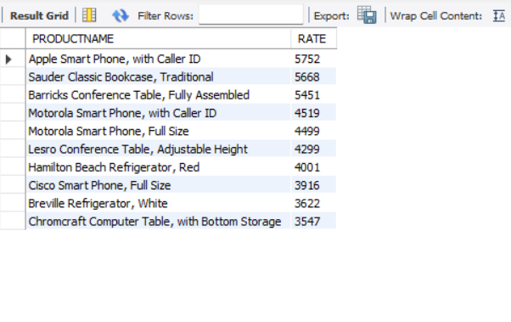
TOP 10 EXPENSIVE PRODUCTS

Slide 11
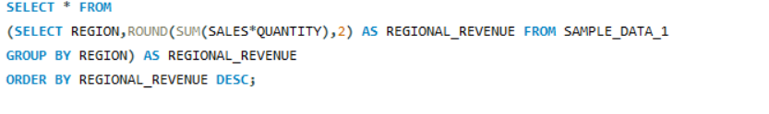
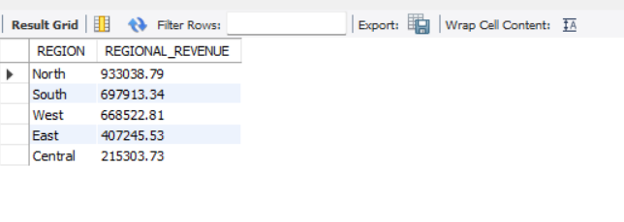
REGION WISE REVENUE

Slide 12
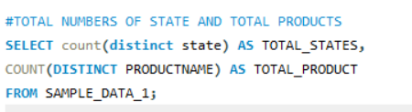
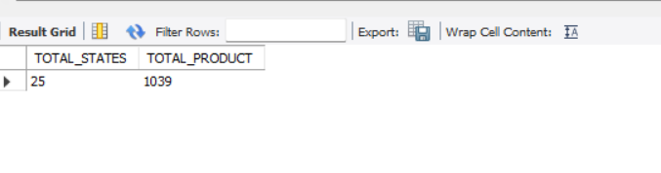
TOTAL STATE AND TOTAL PRODUCTS

